Slide 1
Iterative Control Statements

Slide 2

Iterative Control Statements
Notes:
This presentation demonstrates the new capabilities of PowerPoint and it is best viewed in Slide Show. These slides are designed to give you great ideas for the presentations you’ll create in PowerPoint 2010!
For more sample templates, click the File tab, and then on the New tab, click Sample Templates.

Slide 3
1. Through this lecture, students will understand iterative control statements
2. Students will practice programs using loops
Learning
Outcomes

Slide 4
Contents
Iterative Control statements
While loop
Do-while loop
For loop

Slide 5
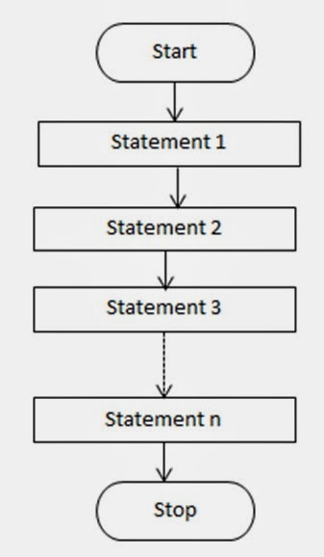
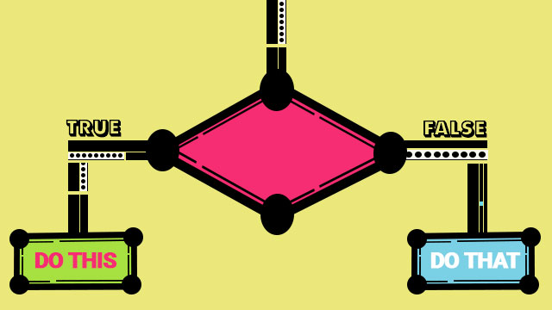
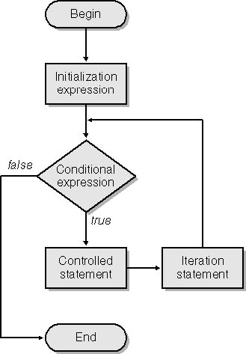
Iterative Control Statements
Conditional Statements
Sequential statements
Iterative control Statements

Slide 6


Slide 7
Iteration / Repetition / Looping in Programs
In most software, the statements in the program may need to repeat for many times.
e.g., calculate the value of n!.
If n = 10000, it’s not elegant to write the code as 1*2*3*…*10000.
Loop is a control structure that repeats a group of steps in a program.
Loop body stands for the repeated statements.
There are three C loop control statements:
While, do-while and for.

Slide 8
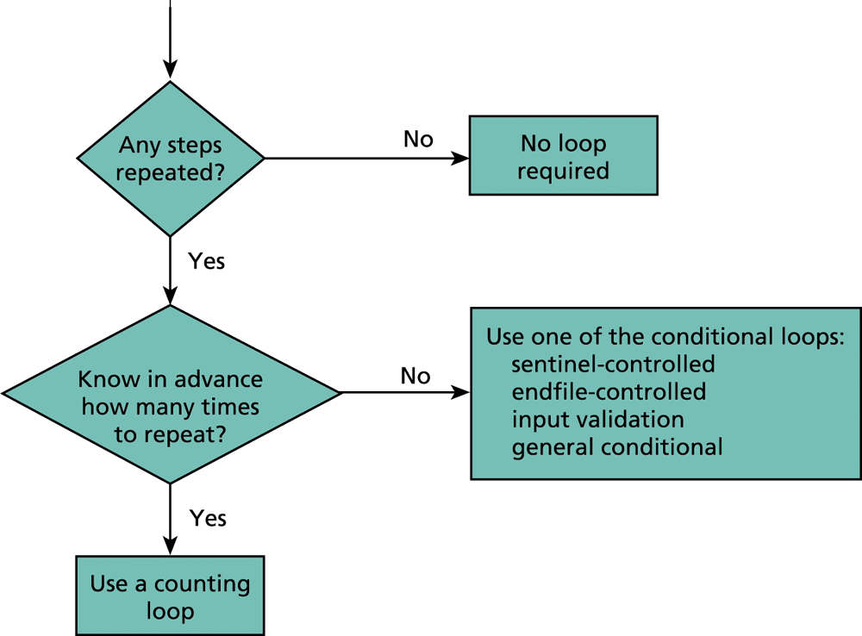
Flow Diagram of Loop Choice Process
e.g., read the content in a file
e.g., calculate the value of n!

Slide 9
Comparison of Loop Choices
Kind | When to Use | C Structure
Counting loop | We know how many loop repetitions will be needed in advance. | while, for
Sentinel-controlled loop | Input of a list of data ended by a special value | while, for
Endfile-controlled loop | Input of a list of data from a data file | while, for

Slide 10
Comparison of Loop Choices (2/2)
Kind | When to Use | C Structure
Input validation loop | Repeated interactive input of a value until a desired value is entered. | do-while
General conditional loop | Repeated processing of data until a desired condition is met. | while, for

Slide 11
The while Statement in C
The syntax of while statement in C:
while (loop repetition condition)
statement
Loop repetition condition is the condition which controls the loop.
The statement is repeated as long as the loop repetition condition is true.

Slide 12
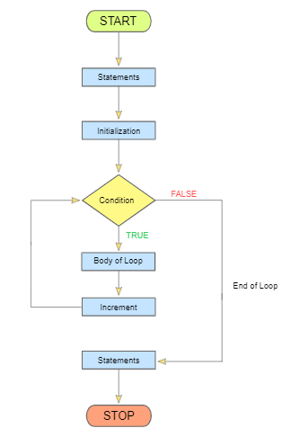
Syntax and flowchart of while loop
while(test condition)
{
Body of the loop .
}

Slide 13
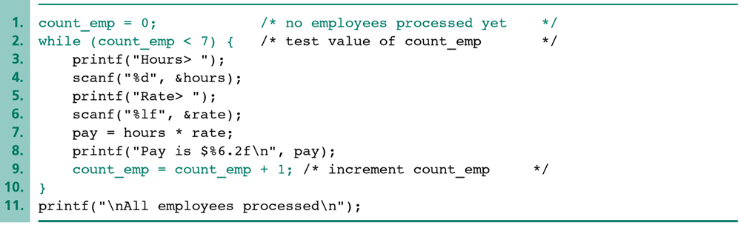
An Example of a while Loop
Loop repetition condition
Statement
Loop control variable is the variable whose value controls loop repetition.
In this example, count_emp is the loop control variable.

Slide 14
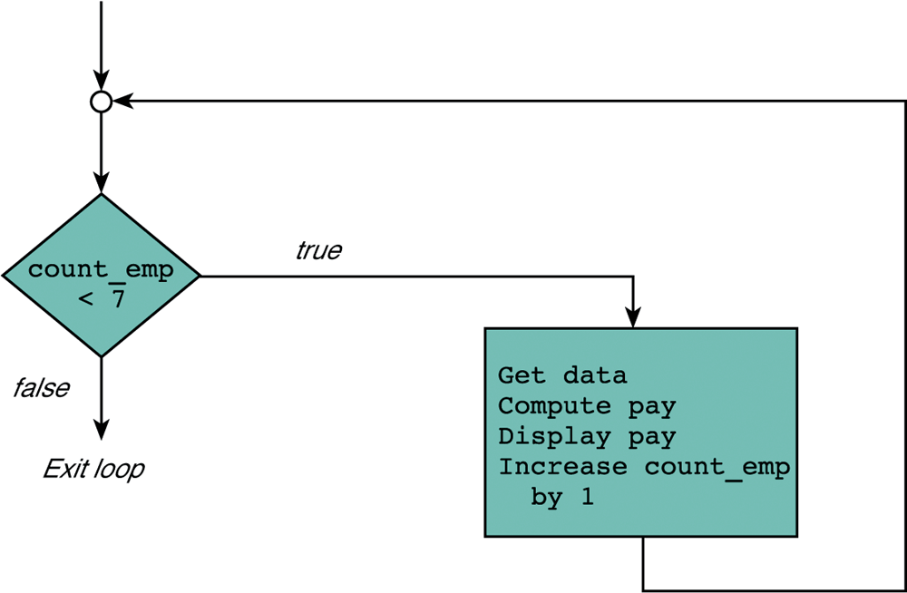
Flowchart for a while Loop
Loop repetition condition
Statement

Slide 15
Nested while loop in C
While loop within while loop is nested while loop.
Loop repetition condition is the condition which controls the loop.
The statement is repeated as long as the loop repetition condition is true.
A loop is called an infinite loop if the loop repetition condition is always true.
Also known as splitted for loop.

Slide 16
The do-while Statement in C
The do while loop evaluates the condition only after the execution of the statements in its body.
The statements within do-while loop is executed at least once. A do while loop is also called as bottom tested loop.
The syntax of do-while statement in C:
do
{ statement 1;
statement n; }
while(test expression);
Even if the test condition in the while loop is false for the very first time, The statements of do-while loop will be executed at least once.

Slide 17
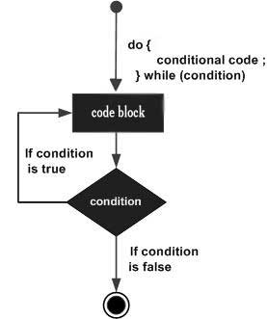

Slide 18
An Example of the do-while Loop
#include <stdio.h>
int main()
{
do
{
printf("I will display once ");
}
while(2 > 10);
return 0;
}

Slide 19
The Nested do-while Statement in C
Using do-while loop within do-while loops is said to be nested do while loop.
The syntax of do-while statement in C:
do {
statement n;
do
{
statement n;
}
while(test condition); }
while(test expression);

Slide 20
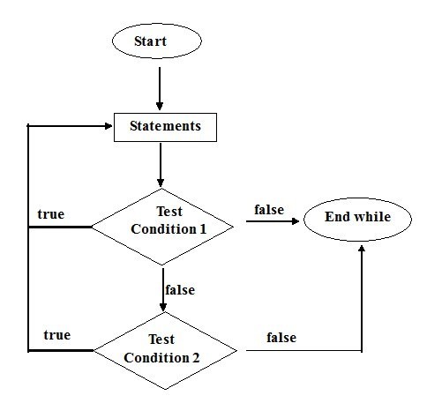

Slide 21
An Example of nested do-while Loop
#include <stdio.h>
int main()
{ do
{ printf("I'm from outer do-while loop ");
do
{printf("\nI'm from inner do-while loop "); }
while(1 > 10); }
while(2 > 10);
return 0; }
The outer do-while loop contains the inner do-while loop. Both the inner and outer statements of do-while loops are executed once, irrespective of their test conditions.

Slide 22
For loop in C
complex than while loop and do while loop
used when you exactly know how many times a block of statement is to be executed repeatedly.
The syntax of for statement in C:
for (initialization expression;
loop repetition condition;
update expression)
statement
The initialization expression set the initial value of the loop control variable.
The loop repetition condition test the value of the loop control variable.
The update expression update the loop control variable.

Slide 23
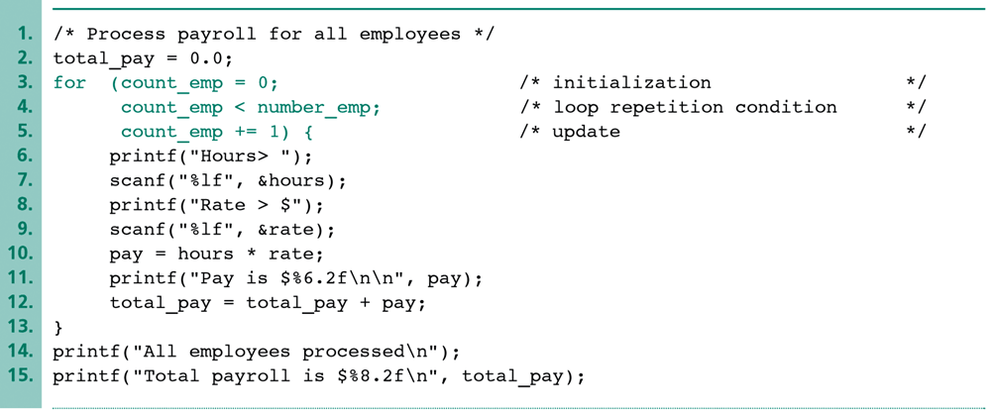
An Example of the for Loop
Initialization Expression
Loop repetition condition
Update Expression
count_emp is set to 0 initially.
count_emp should not exceed the value of number_emp.
count_emp is increased by one after each iteration.

Slide 24
Increment and Decrement Operators
Increment and decrement statements are commonly used in the for loop.
The increment (i.e., ++) or decrement (i.e., --) operators are the frequently used operators which take only one operand.
The increment/decrement operators increase or decrease the value of the single operand.
e.g., for (int i = 0; i < 100; i++){ … }
The variable i increases one after each iteration.

Slide 25
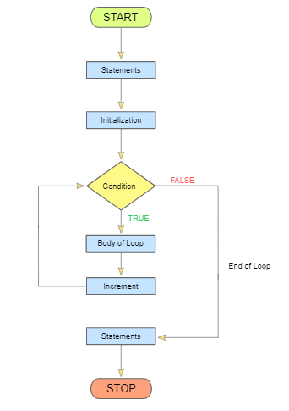
For Loop Flowchart

Slide 26
Infinite for loop
When the for statement contains no test condition between the ;(semicolon)
#include <stdio.h>
int main()
{
int a = 1;
for( ; ; )
{
printf("%d ", a++);
}
return 0;
}
Output: 12345.........

Slide 27
Nested for loop
for loop within another for loop is said to be nested for loop.
In nested for loop, the number of iterations will be equal to the number of iterations in the outer loop multiplies by the number of iterations in the inner loop.
Syntax:
for (initialize counter; test condition; ++ or --)
{
for (initialize counter; test condition; ++ or --)
{ .// inner for loop
}
.// outer for loop
}

Slide 28
Nested Loops
Nested loops consist of an outer loop with one or more inner loops.
e.g.,
for (i=1;i<=100;i++){
for(j=1;j<=50;j++){
…
}
}
The above loop will run for 100*50 iterations.
Outer loop
Inner loop

Slide 29
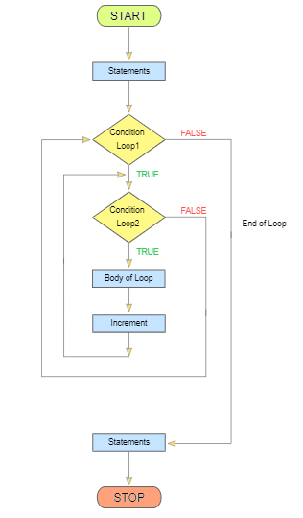
Flowchart for Nested for loop

Slide 30
Example of Nested for loop
#include <stdio.h>
int main()
{
int a, b;
for(a = 1; a <= 5; a++)
{
for(b = 1; b <= 5; b++)
{ printf("%d ", b); }
printf("\n");
}
return 0;
}
Output:
12345
12345
12345
12345
12345

Slide 31
Program to calculate simple interest using 3 sets of p,n,r
main()
{ int p, n, count;
float r,si;
count=1;
while(count<=3)
{
printf(“Enter the value of p, n, r”);
scanf(“%d %d %f”, &p, &n, &r);
si=p*n*r/100;
printf(“Simple interest = Rs. %f”, si);
count=count+1;
} }
Using while loop

Slide 32
Program to calculate simple interest using 3 sets of p,n,r
main()
{ int p, n, count;
float r, si;
for(count=1;count<=3;count=count+1)
{
printf(“Enter the value of p, n, r”);
scanf(“%d %d %f”, &p, &n, &r);
si=p*n*r/100;
printf(“Simple interest = Rs. %f”, si);
}
}
Using for loop

Slide 33
Find factorial of a number (using while and for loop)
Write a program to add first seven terms of the following series using a for loop
1 /1! 2/2! 3/3! ……
Program to check whether the number is armstrong or not.
Program to count frequency of digits in a number
Program to find power of number using for and while loop.
Implement C programs

Slide 34
Quiz

Slide 35
What will be the output of the C program?
main( )
{
int j ;
while ( j <= 10 )
{
printf ( "\n%d", j ) ;
j = j + 1 ; } }
2. main( )
{ int x = 4, y, z ;
y = --x ;
z = x-- ;
printf ( "\n%d %d %d", x, y, z ) ;
}

Slide 36
3. main( )
{
float x = 1.1 ;
while ( x == 1.1 )
{
printf ( "\n%f", x ) ;
x = x – 0.1 ; } }
4. #include <stdio.h>
int main()
{ int i = 0;
while (i = 0)
printf("True\n");
printf("False\n");
}
a) True (infinite time) b) True (1 time) False c) False d) Compiler dependent

Slide 37
5. #include <stdio.h>
int main()
{ int i = 1024;
for (; i; i >>= 1)
printf(“Hello");
return 0; }
How many times will Hello be printed in the above program?
10 B) 11 C) Infinite D) The program will show compile-time error
#include<stdio.h>
#define loop for( ; ; )
int main()
{
printf("DONE");
loop;
return 0;
}
A. Compilation error B. Done C. Program never ends D. None of the above

Slide 38
7. #include<stdio.h>
int main()
{ int i = 1, j = 1;
for( ;j ; printf("%d %d ",i, j))
j = i++ <= 1;
return 0; }
A. 1 2 3 0 B. 1 1 2 2 C. 2 1 3 0 D. 0 1 2 3
#include<stdio.h>
int main()
{ int rows = 3, columns = 4, i, j, k;
int a[3][4] = {23, 46, 69, 102, 99, 109};
i = j = k = 99;
for(i = 0;i>rows;i++)
for(j = 0;j>columns;j++)
if(a[k][j]>k) k = a[i][j];
printf("%d\n", k);
return 0; }
A. 99 B. 102 C. 109 D. None of the above

Slide 39
9. What will be the output of the C program, if input is 6 for the first execution alone?
#include<stdio.h>
int i;
int main()
{
int t;
for (t=4; scanf("%d",&i)-t; printf("%d\n",i))
printf("%d--", t--); return 0; }
A. 4--6 B. 6-- C. 4-- D. None of the above
10. What will be the output of the C program?
#include<stdio.h>
int main()
{ char i = 0;
for(; i>=0; i++);
printf("%d\n", i);
return 0; }
A. Compilation error B. -128 C. 0 D. 1

Slide 40
11. #include<stdio.h>
int main()
{ int i = 0;
while(i < 3, i = 0, i < 5)
{ printf("Loop ");
i++; }
return 0; }
A. Loop Loop Loop Loop Loop B. Infinite Loop C. Loop Loop Loop D. Prints Nothing
12. What will be the output of the C program?
#include<stdio.h>
int main()
{ int i = 0;
while(i++)
{
printf("Loop ");
if(i == 3) break; }
return 0; }
A. Loop B. Loop Loop Loop C. Loop Loop Loop Loop D. Prints Nothing

Slide 41
13. What will be the output of the C program?
#include<stdio.h>
int main()
{ int i = 4;
while(i == 4--)
printf("Loop ");
return 0; }
A. Loop Loop Loop Loop B. Loop Loop loop C. Compilation Error D. Prints Nothing
14. #include<stdio.h>
int main()
{ int i = 1;
while(printf("%d", 5) == 1 == i)
{ printf("SuperLoop "); }
return 0; }
A. 5Super Loop B. Prints Nothing C. 5SuperLoop 5SuperLoop 5SuperLoop 5SuperLoop 5SuperLoop D. Infinite Times

Slide 42
15. #include<stdio.h>
int main()
{ float ft = 7.5;
while(ft)
{ printf("Loop");
ft = ft - .5;
if(ft == 5.0f) break; }
return 0; }
A. Prints Nothing B. Looop C. Loop Loop Loop Loop Loop D. Compilation Error
16. What will be the output of the C program?
#include<stdio.h>
int main()
{ while(!!7)
printf("Hai");
return 0; }
A. Hai Hai Hai Hai Hai Hai Hai B. Hai C. Infinite Loop D. Prints Nothing

Slide 43
17. #include<stdio.h>
int main()
{ int i = -1;
do { printf("HiDoWhile "); }
while(i++);
return 0; }
A. Compilation Error B. HiDoWhile
C. HiDoWhile HiDoWhile HiDoWhile D. HiDoWhile HiDoWhile

Slide 44
Thank You......

